Slide 1
Hangman Project by Group 16
Members:- Gimhani Kaushalya Garusing Arachchige
Xin Yuan
Mengyuan Li
Le Phuoc Hoang Dan
Xiuru Kang

Slide 2

Why We Select This project?
Group member Dan Le said “Having great knowledge about this types of project” and all other members are giving their consent on the topic.

Slide 3
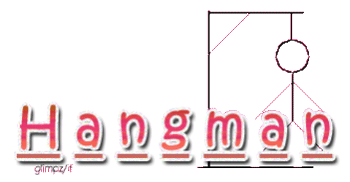
Our Project
Let’s play now.

Slide 4
How does the game works?
Steps of Creation

Slide 5
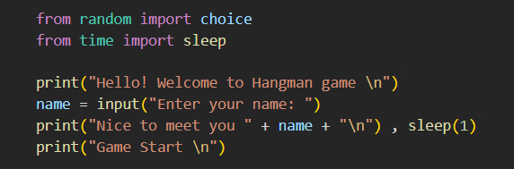
Step 1
Import modules
Print welcome words
Ask the player to type out their name
Game Start ......

Slide 6
Step 2 Define values that we are going to need later
1. Set a word base
2. Choose a word from the word base
3. Turn the word into “_” with the same amount of letter
4. Set a “count” value, for counting how many times the play fail
5. Set a value that include the correct letter that the player already guessed

Slide 7
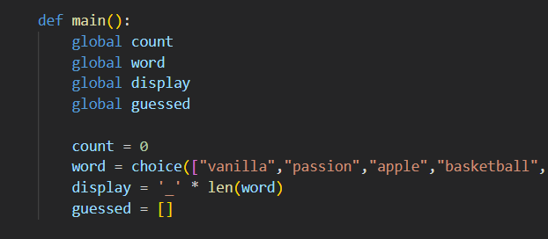

Slide 8

Step 3 Set the main game rule
1. Set a limit number of trials
2. Player can start guessing

Slide 9
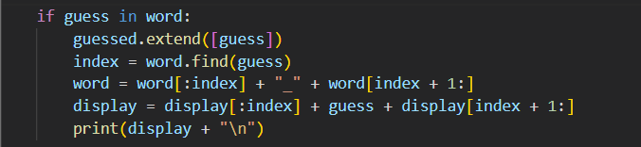
Step 3 Set the main game rule
If the player got the correct letter:

Slide 10


Step 3 Set the main game rule
If the player types in invalid amount of letters, or types in a number:
If the player types a letter that is already in the word, and there are no such letter in the word anymore:

Slide 11
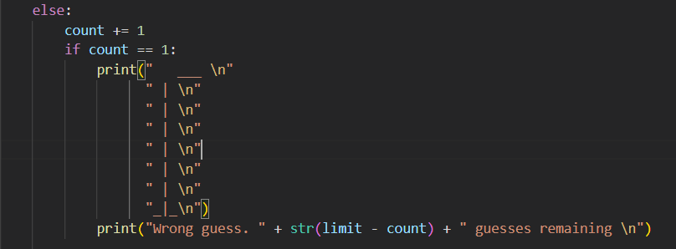
If the player types in the wrong letter:

Slide 12
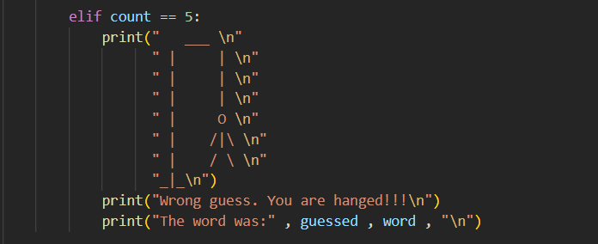
After 5 wrong trials:

Slide 13
Step 3 Set the main game rule
When the player guess all the letters correctly:
If the player haven’t guess all the letters:

Slide 14

Step 4 Game Start ! (Finally)
Run the “def” codes we set before:

Slide 15
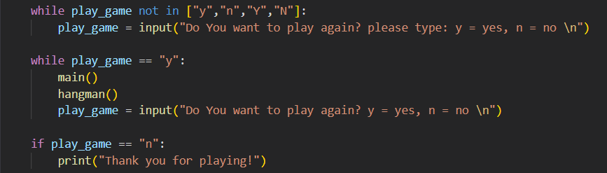
Step 5
After the player finished the game, ask if he wants to play again

Slide 16

Challengers that we faced.
Find time to gather all.
Finalize the work done by each person.
Communication problems.

Slide 17

How we overcome that challengers
Make “whatsApp” group.
Share Ideas of all members.
Communicate with each member.
Arrange Zoom meeting to finalize the project Work.

Slide 18
Thank you for your Attention.

